Slide 1
Winter holiday ACTIVITIES What activities can we try in the holidays and what local places can we visit?
Sauda Allen – Learning Mentor

Slide 2
Agenda
Holiday and Food Programme
Hackney’s 10x10 Programme
Holiday Homework
Free activities in London
Winter Crafts

Slide 3
Hackney Holiday Activities and food programme (HAF)
Free activities such as : Sports, Drama, Arts, Mentoring, Cooking, Photography…
Google search : Holiday activities and food programme hackney.

Slide 4
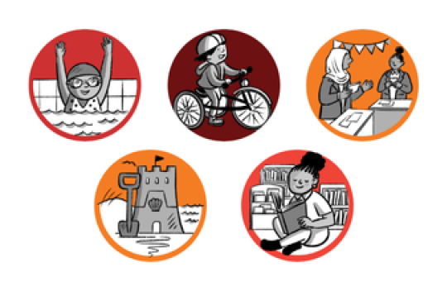
Hackney 10x10 programme
An initiative to support every child in Hackney achieve 10 amazing activities by the time they are 10 years old.
Have a musical experience, learn to swim, take part in drama, visit the seaside, experience museums, camping, learn to ride a bike, take part in debating, use a library, engage in exercise.

Slide 5
Holiday homework
Encourage your child to investigate on their topic
When possible, facilitate learning by taking them to museums or spaces that will further support your child
Help them, but don’t do it for them
Make the holiday homework a family project where all involved spend some quality time
Bring it to school so that your child’s work and effort can be celebrated

Slide 6
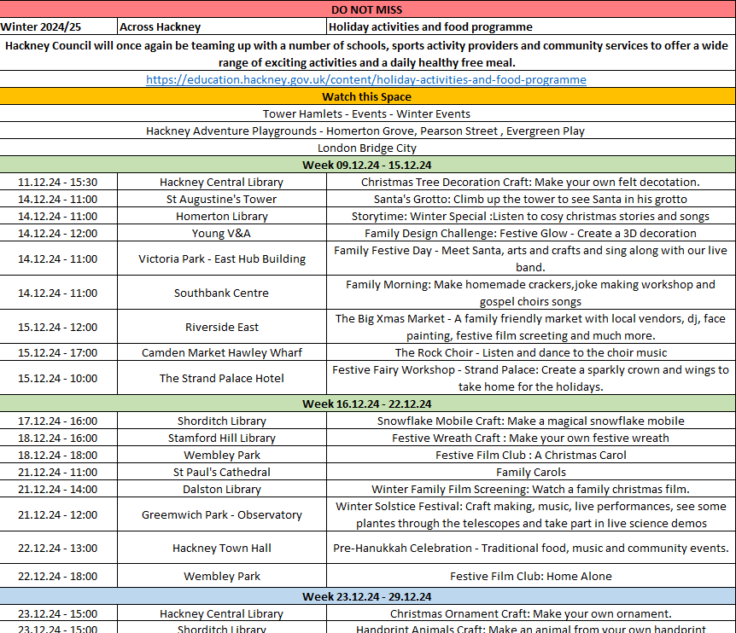
Free activities in London
TAKE A COPY OF THE AGENDA →

Slide 7
- Fold your paper (Hot dog style) - Draw a line around 1 cm from the top.(Open side) - Cut A line from the folded side up to the previous line. (Repeat) (Do not go over the marked line) - Unfold. - Fold the wreath back on itself to create a tube shape and glue. - Bend the tube to create a circular shape and attach the ends with glue. - Decorate

Slide 8
THANK YOU
Sauda Allen – Learning Mentor

